Slide 1

Concepts in Enterprise Resource Planning
Fourth Edition
Chapter Seven
Process Modeling, Process Improvement, and ERP Implementation

Slide 2
Objectives
After completing this chapter, you will be able to:
Use basic flowcharting techniques to map a business process
Develop an event process chain (EPC) diagram of a basic business process
Evaluate the value added by each step in a business process
Concepts in Enterprise Resource Planning, Fourth Edition
Concepts in Enterprise Resource Planning, Fourth Edition

Slide 3
Objectives (cont’d.)
Develop process improvement suggestions
Discuss the key issues in managing an ERP implementation project
Describe some of the key tools used in managing an ERP implementation project
Concepts in Enterprise Resource Planning, Fourth Edition
Concepts in Enterprise Resource Planning, Fourth Edition

Slide 4
Introduction
Tools that can be used to describe business processes
  Flowcharts, event process chains
  Not specific to ERP
  Can help managers identify process elements that can be improved
Role of process-modeling tools in ERP implementation projects
Concepts in Enterprise Resource Planning, Fourth Edition

Slide 5
Process Modeling
Business processes can be quite complex
Process model: any abstract representation of a process
Process-modeling tools provide a way to describe a business process so that all participants can understand the process
Concepts in Enterprise Resource Planning, Fourth Edition

Slide 6
Process Modeling (cont’d.)
Advantages of process models
  Graphical representations are usually easier to understand than written descriptions
  Provide a good starting point for analyzing a process
    Participants can design and implement improvements
  Document the business process
    Easier to train employees to support the business process
Concepts in Enterprise Resource Planning, Fourth Edition

Slide 7
Flowcharting Process Models
Flowchart
  Any graphical representation of the movement or flow of concrete or abstract items
  Clear, graphical representation of a process from beginning to end
  Uses a standardized set of symbols
Process mapping
  Often used interchangeably with flowcharting
  Specifically refers to activities occurring within an existing business process
Concepts in Enterprise Resource Planning, Fourth Edition

Slide 8
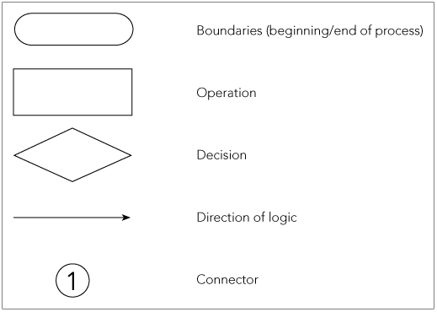
Flowcharting Process Models (cont’d.)
Figure 7-1 Basic flowcharting symbols
Concepts in Enterprise Resource Planning, Fourth Edition

Slide 9
Fitter Snacker Expense Report Process
Maria, Fitter Snacker salesperson
  Completes a paper expense report after travel
  Makes a copy for her records
  Attaches receipts for any expenses over $25
  Mails it to her zone manager at the branch office
Kevin, zone manager
  Reviews expense report
  Approves report or mails it back to Maria asking for explanation, verification, or modification
  After approval, mails it to corporate office
Concepts in Enterprise Resource Planning, Fourth Edition

Slide 10
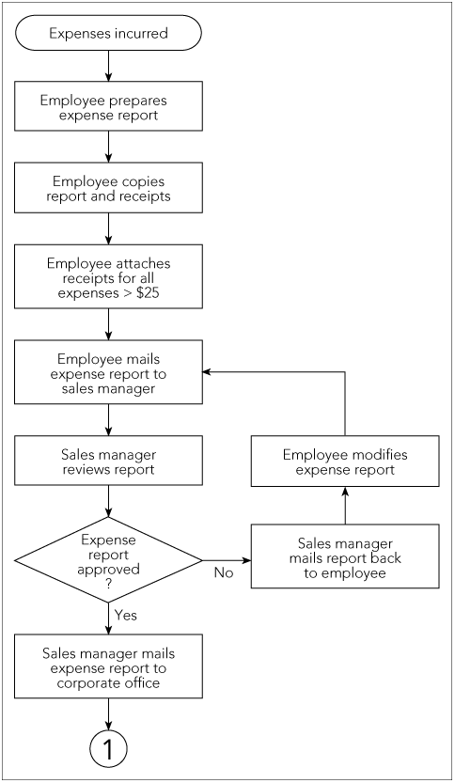
Figure 7-2 Partial process map for Fitter Snacker expense-reporting process
Concepts in Enterprise Resource Planning, Fourth Edition

Slide 11
Fitter Snacker Expense Report Process (cont’d.)
Process at corporate office
  Accounts payable (A/P) clerk
Process boundaries define:
  Which activities are to be included in the process
  Which activities are considered part of environment—external to process
All processes should have only one beginning point and one ending point
Decision diamond asks a question that can be answered with “yes” or “no”
Concepts in Enterprise Resource Planning, Fourth Edition

Slide 12
Extensions of Process Mapping
Hierarchical modeling: ability to flexibly describe a business process in greater or less detail, depending on the task at hand
Modeling software that supports hierarchical modeling
  Provides user the flexibility to move easily from higher-level, less detailed views to the lower-level, more detailed views
Concepts in Enterprise Resource Planning, Fourth Edition

Slide 13
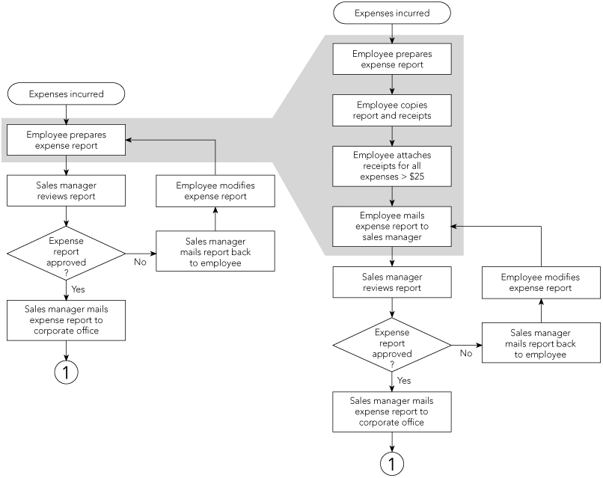
Figure 7-3 Hierarchical modeling of Fitter’s expense-reporting process
Concepts in Enterprise Resource Planning, Fourth Edition

Slide 14
Extensions of Process Mapping (cont’d.)
Deployment flowcharting
  Swimlane flowchart
  Depicts team members across the top
  Each step is aligned vertically under the appropriate employee or team
  Clearly identifies each person’s tasks in the process
Concepts in Enterprise Resource Planning, Fourth Edition

Slide 15
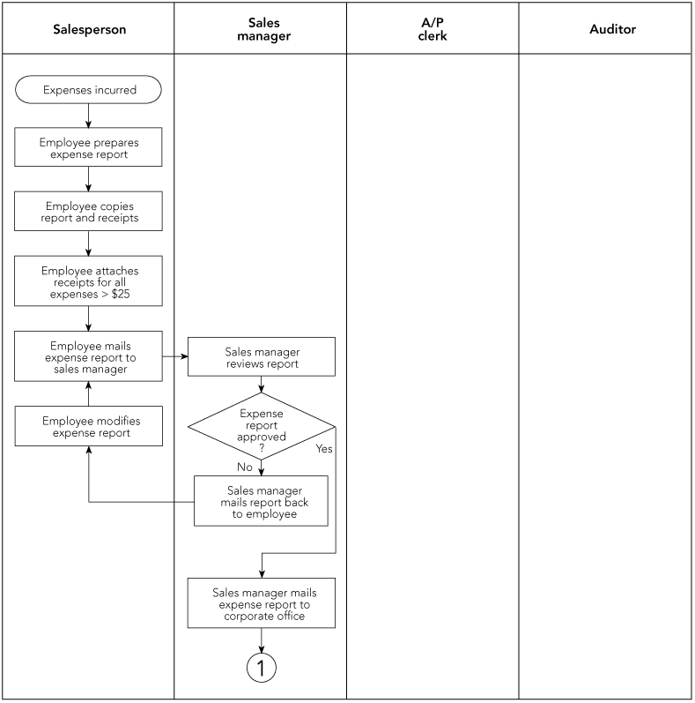
Figure 7-4 Deployment, or swimlane, flowcharting of the Fitter’s expense report process
Concepts in Enterprise Resource Planning, Fourth Edition

Slide 16
Event Process Chain (EPC) Diagrams
Event process chain (EPC) format
  Uses only two symbols to represent a business process
  Matches the logic and structure of SAP’s ERP software design
  Two structures: events and functions
    Events: a state or status in the process
    Functions: part of the process where change occurs
Concepts in Enterprise Resource Planning, Fourth Edition

Slide 17
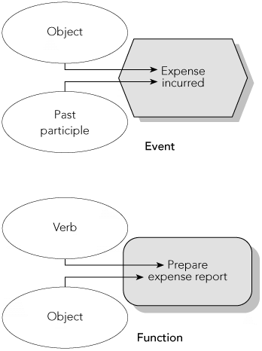
Event Process Chain (EPC) Diagrams (cont’d.)
Figure 7-5 EPC components
Concepts in Enterprise Resource Planning, Fourth Edition

Slide 18
Event Process Chain (EPC) Diagrams (cont’d.)
EPC software
  Enforces an event-function-event structure
  Standardized naming convention for functions and events
Three types of branching connectors
  AND
  OR
  Exclusive OR (XOR)
Basic EPC diagram can be augmented with additional information
Concepts in Enterprise Resource Planning, Fourth Edition

Slide 19
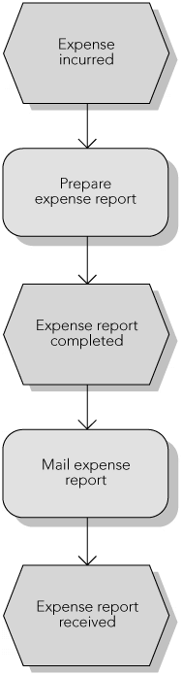
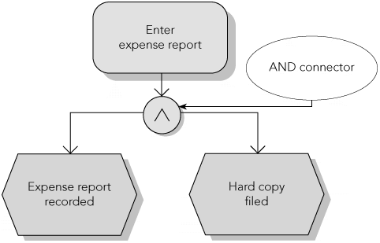
Figure 7-6 Basic EPC layout
Figure 7-7 AND connector
Concepts in Enterprise Resource Planning, Fourth Edition

Slide 20
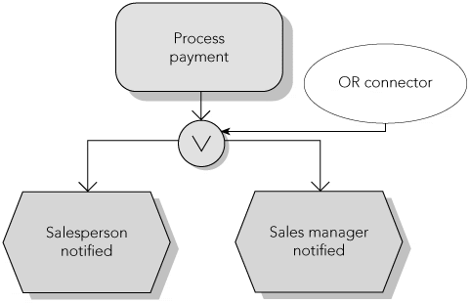
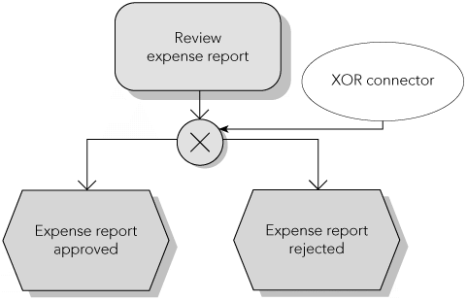
Event Process Chain (EPC) Diagrams (cont’d.)
Figure 7-8 OR connector
Figure 7-9 XOR connector
Concepts in Enterprise Resource Planning, Fourth Edition

Slide 21
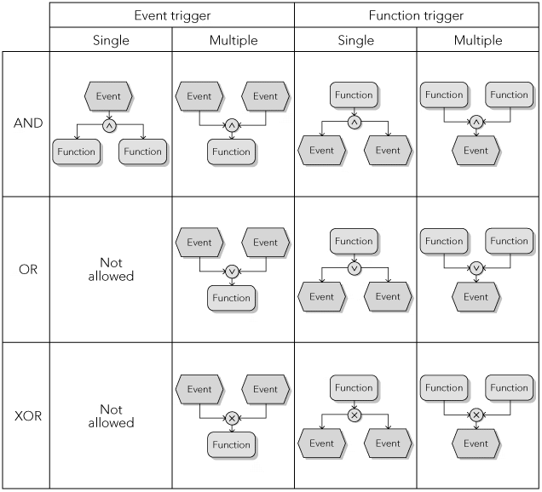
Figure 7-11 Possible connector and triggering combinations
Concepts in Enterprise Resource Planning, Fourth Edition

Slide 22
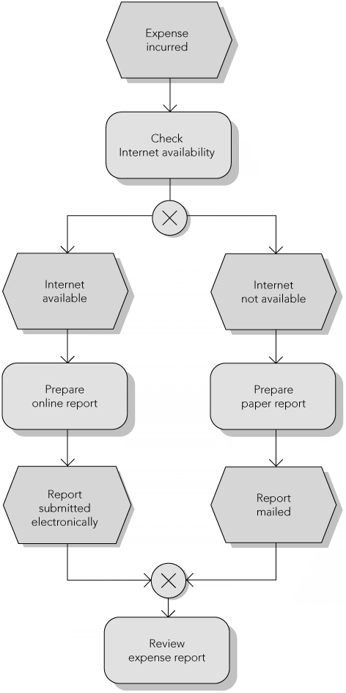
Figure 7-12 Splitting and consolidating paths
Concepts in Enterprise Resource Planning, Fourth Edition

Slide 23
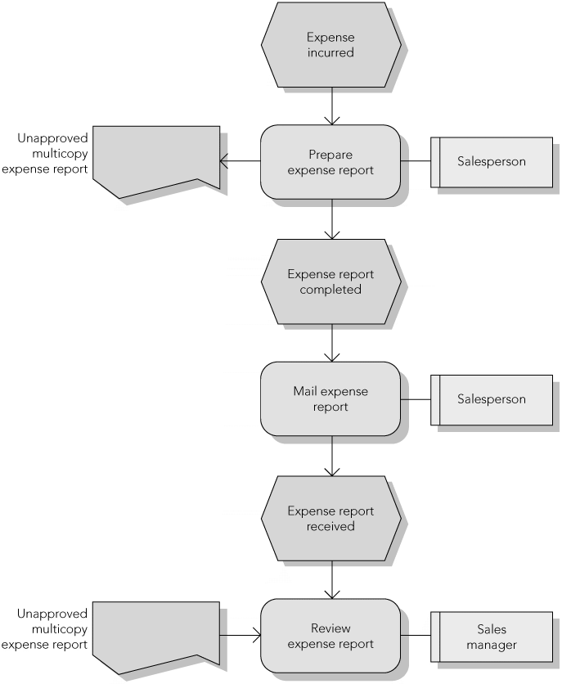
Figure 7-13 EPC diagram with organizational and data elements
Concepts in Enterprise Resource Planning, Fourth Edition

Slide 24
Process Improvement
Value analysis
  Each activity in the process is analyzed for the value it adds to the product or service
  Value added is determined from the perspective of customer
  Real value: value for which the customer is willing to pay
  Business value: value that helps the company run its business
  No value: an activity that should be eliminated
Concepts in Enterprise Resource Planning, Fourth Edition

Slide 25
Evaluating Process Improvement
Disrupting the current process to make changes can be costly and time consuming
Dynamic process modeling takes a basic process flowchart and puts it into motion
  Uses computer simulation techniques to facilitate the evaluation of proposed process changes
Computer simulation
  Uses repeated generation of random variables that interact with a logical model of the process
  Predict performance of the actual system
Concepts in Enterprise Resource Planning, Fourth Edition

Slide 26
ERP Workflow Tools
Workflow tools
  Software programs that automate the execution of business processes and address all aspects of a process, including:
    Process flow (logical steps in the business process)
    People involved (the organization)
    Effects (the process information)
ERP software provides a workflow management system
  Supports and speeds up business processes
Concepts in Enterprise Resource Planning, Fourth Edition

Slide 27
ERP Workflow Tools (cont’d.)
Workflow tasks: links that can include basic information, notes, documents, and direct links to business transactions
SAP system can:
  Monitor workflow tasks
  Automatically take various actions if the tasks are not completed on time
Concepts in Enterprise Resource Planning, Fourth Edition

Slide 28
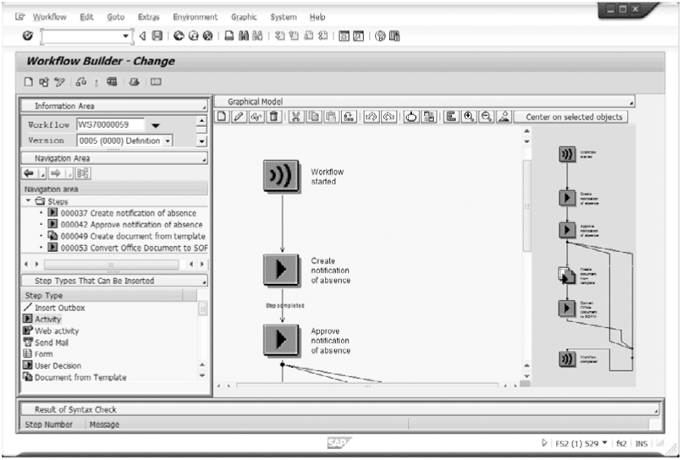
Figure 7-14 SAP ERP Workflow Builder screen
Concepts in Enterprise Resource Planning, Fourth Edition

Slide 29
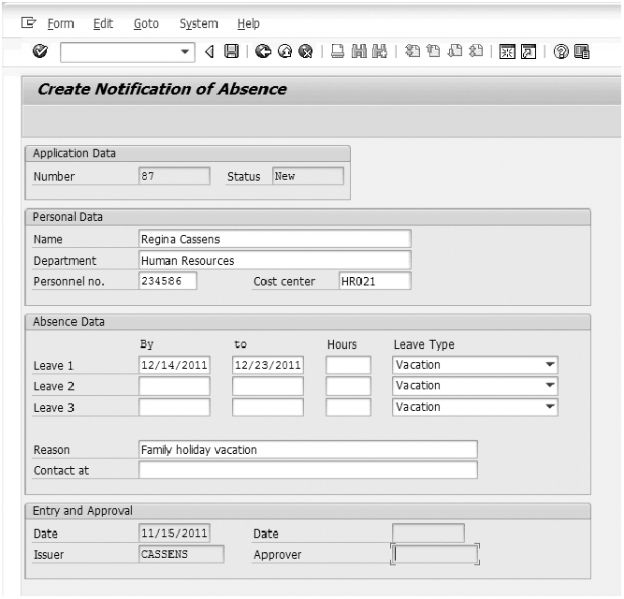
Figure 7-15 Create notification of absence screen
Concepts in Enterprise Resource Planning, Fourth Edition

Slide 30
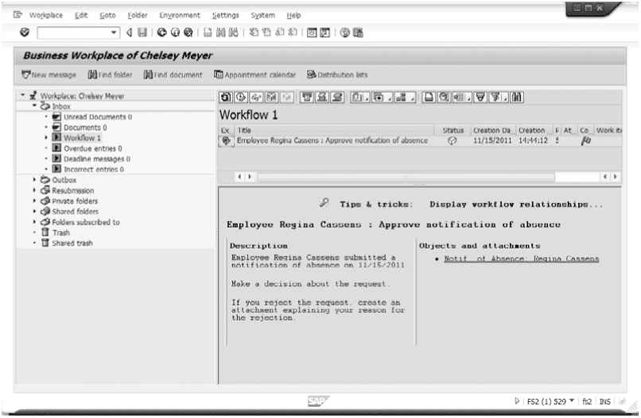
Figure 7-16 Manager’s Business Workplace with workflow task
Concepts in Enterprise Resource Planning, Fourth Edition

Slide 31
ERP Workflow Tools (cont’d.)
Workflow provides a number of useful features
  Employees can track progress of workflow tasks
  System can be programmed to send reminders to employee(s) responsible for a task
  For sporadic processes, workflow tools are a powerful way to improve process efficiency and effectiveness
Concepts in Enterprise Resource Planning, Fourth Edition

Slide 32
Implementing ERP Systems
Late 1990s: many firms rushed to implement ERP systems to avoid the Y2K problem
Since 2000: pace of implementations has slowed considerably
  Most Fortune 500 firms have implemented an ERP system
  Current growth is in the small to midsized business market
Implementation of ERP is an ongoing process
Concepts in Enterprise Resource Planning, Fourth Edition

Slide 33
ERP System Costs and Benefits
ERP implementation is expensive
  Usually ranging between $10 million and $500 million, depending on company size
Costs of ERP implementation
  Software licensing fees
  Consulting fees
  Project team member time
  Employee training
  Productivity losses
Concepts in Enterprise Resource Planning, Fourth Edition

Slide 34
ERP System Costs and Benefits (cont’d.)
Companies must identify a significant financial benefit that will be generated by ERP system
Only way companies can save money with ERP systems is by using them to support more efficient and effective business processes
Companies must manage transfer of data from old computer systems to new ERP system
Concepts in Enterprise Resource Planning, Fourth Edition

Slide 35
Implementation and Change Management
Key challenge is not in managing technology, but in managing people
ERP system changes how people work
  To be effective, change may have to be dramatic
  Business processes that are more effective require fewer people
  Some employees may be eliminated from their current jobs
Concepts in Enterprise Resource Planning, Fourth Edition

Slide 36
Implementation and Change Management (cont’d.)
Organizational change management (OCM): managing the human behavior aspects of organizational change
People do not mind change, they mind being changed
If ERP implementation is a project that is being forced on employees, they will resist it
When employees have contributed to a process change, they have a sense of ownership and will likely support the change
Concepts in Enterprise Resource Planning, Fourth Edition

Slide 37
Implementation Tools
Many tools are available to help manage implementation projects
  Example: process mapping
SAP provides Solution Manager tool
  Helps companies manage implementation of SAP ERP
Concepts in Enterprise Resource Planning, Fourth Edition

Slide 38
Implementation Tools (cont’d.)
In Solution Manager, ERP implementation project is presented in a five-phase Implementation Roadmap:
  Project Preparation (15 to 20 days)
  Business Blueprint (25 to 40 days)
  Realization (55 to 80 days)
  Final Preparation (35 to 55 days)
  Go Live and Support (20 to 24 days)
Concepts in Enterprise Resource Planning, Fourth Edition

Slide 39
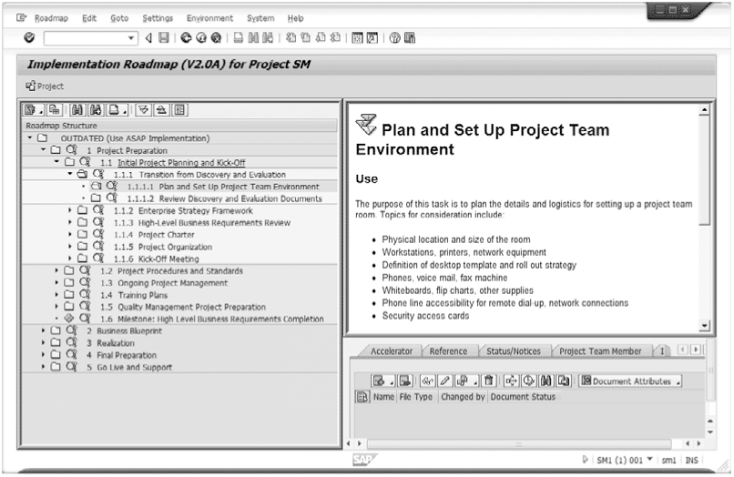
Figure 7-17 Implementation Roadmap in Solution Manager
Concepts in Enterprise Resource Planning, Fourth Edition

Slide 40
Implementation Tools (cont’d.)
Project Preparation
  Organizing technical team
  Defining system landscape
  Selecting hardware and database vendors
  Defining project’s scope
    Scope creep
Business Blueprint
  Produces detailed documentation of business process requirements of the company
Concepts in Enterprise Resource Planning, Fourth Edition

Slide 41
Implementation Tools (cont’d.)
Realization
  Project team members work with consultants to configure the ERP software in development system
Final Preparation
  Testing the system throughput for critical business processes
  Setting up help desk for end-users
  Setting up operation of the Production (PROD) system and transferring data from legacy systems
  Conducting end-user training
  Setting Go Live date
Concepts in Enterprise Resource Planning, Fourth Edition

Slide 42
Implementation Tools (cont’d.)
Go Live and Support
  Company begins using new ERP system
  Monitoring of system is critical so that changes can be made quickly if performance of the system is not satisfactory
  Important to set a date at which the project will be complete
Concepts in Enterprise Resource Planning, Fourth Edition

Slide 43
System Landscape Concept
SAP recommends a system landscape for implementation
  Three completely separate SAP systems:
    Development (DEV)
    Quality Assurance (QAS)
    Production (PROD)
  Transport directory: special data file location on DEV server
Concepts in Enterprise Resource Planning, Fourth Edition

Slide 44
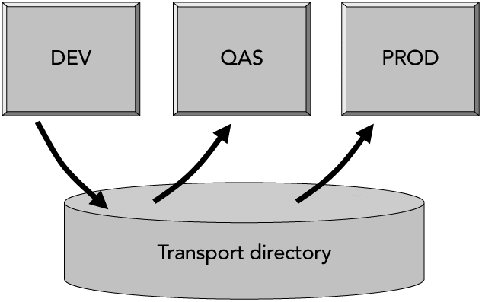
System Landscape Concept (cont’d.)
Figure 7-18 System landscape for SAP ERP implementation
Concepts in Enterprise Resource Planning, Fourth Edition

Slide 45
System Landscape Concept (cont’d.)
Development (DEV) system used to develop configuration settings and special enhancements using ABAP code
Changes recorded in transport directory
Changes imported into QAS system
QAS system: changes are tested
All settings, programs, and changes that pass testing are transported to PROD system
PROD system: used by company to run its business processes
Concepts in Enterprise Resource Planning, Fourth Edition

Slide 46
Summary
Business processes
  ERP systems are designed to provide the information, analysis tools, and communication abilities to support efficient and effective business processes
  Process modeling: fundamental tool in understanding and analyzing business processes
Concepts in Enterprise Resource Planning, Fourth Edition

Slide 47
Summary (cont’d.)
Process mapping: process-modeling tool that uses graphical symbols to document business processes
  Other methodologies: hierarchical modeling, deployment flowcharting, event process chain diagramming, value analysis, and business process improvement
  SAP’s Solution Manager: set of tools and information that can be used to guide an implementation project
    Included in SAP ERP to help manage the implementation of ERP software
Concepts in Enterprise Resource Planning, Fourth Edition

Slide 48
Summary (cont’d.)
SAP’s system landscape was introduced to show how changes to ERP system during implementation (and beyond) are managed
Most challenges to ERP implementation involve managing personnel and their reactions to the change, rather than managing technical issues
Concepts in Enterprise Resource Planning, Fourth Edition

